Slide 1
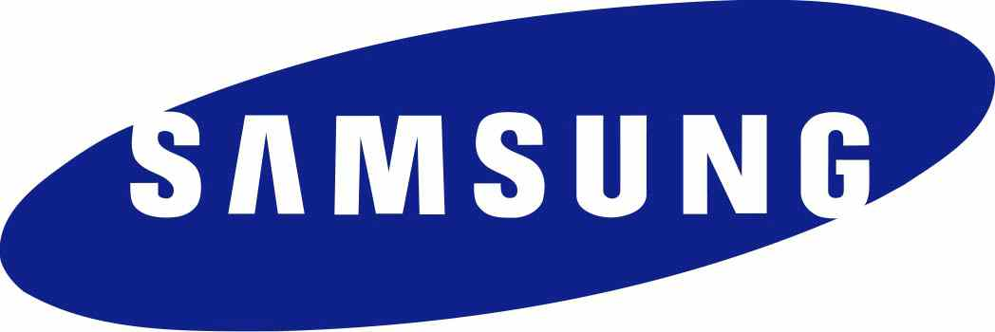
F.P.P – SAMSUNG
By Alain DRILLON

Slide 2
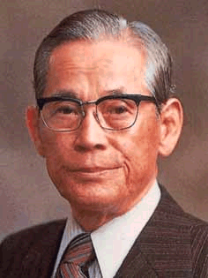
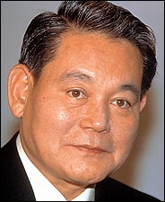
Basic Information
South Korean
Electronics, chemicals, medical equipment, ships, construction, home appliances,...
Created in 1938 by Lee Byungchul
Current CEO : Lee Kun-Hee
369 000 employees
Revenue of US$247.5 billion
Net income of US$18.3 billion

Slide 3


Identity
“Imagine the possibilities”
Samsung means “three stars”
4 different logos

Slide 4
Identity
Name in English
The blue oval is the Earth's orbit
Letters S and G slightly go out the blue shape

Slide 5
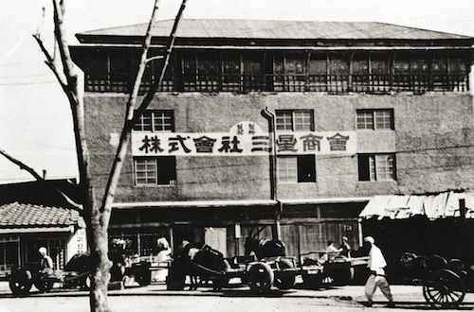

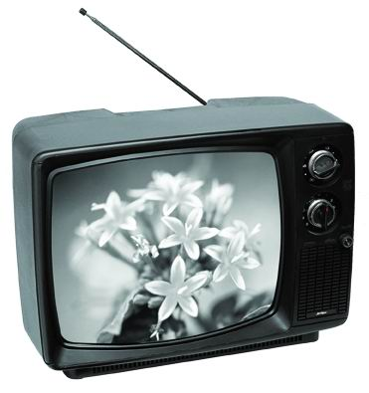
History
1938 : Creation of Samsung Sanghoe, a retail company
1947 : Headquarters moved to Seoul
1953 : Lee Byungchul is forced to leave Seoul and creates the sugar refinery Cheil Jedang
1958 : The company turns into Samsung Group
1968 : Samsung Group formed several electronics-related divisions

Slide 6
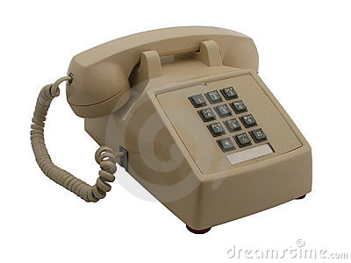
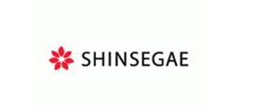

History
1980 : Samsung Group acquired Hanguk Jeongja Tongsin, starts producing communications devices
1986 : All the electronics-related divisions are merged into Samsung Electronics
1987 : Lee Byungchul dies
1989 : Samsung Group splits into Samsung, Shinsegae, CJ, Hansol

Slide 7

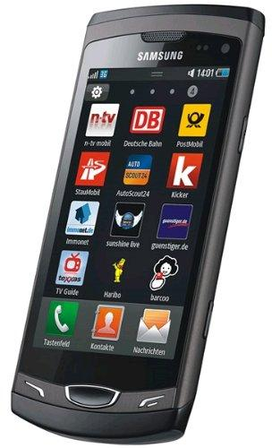
History
1991 : Shinsegae, CJ, Hansol become independents
1993 : Divisions are merged into Samsung Electronics, Samsung Engineering, Samsung Industries
1999 : Foundation of the Korean Aerospace Industries
2012 : Samsung becomes the world's largest mobile phone manufacturer

Slide 8

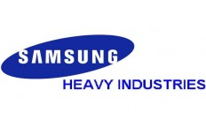

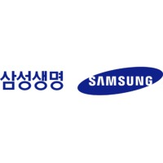


Importance
Samsung Electronics : world's largest IT company
Samsung Heavy Industries : world's 2nd largest shipbuilder
Samsung Engineering : worlds 35th largest construction company
Samsung C&T : world's 72th largest construction company
Samsung Life Insurance : world's 14th largest insurance company
Cheil Worldwide : world's 19th largest advertising agency

Slide 9
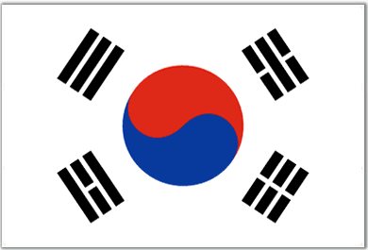

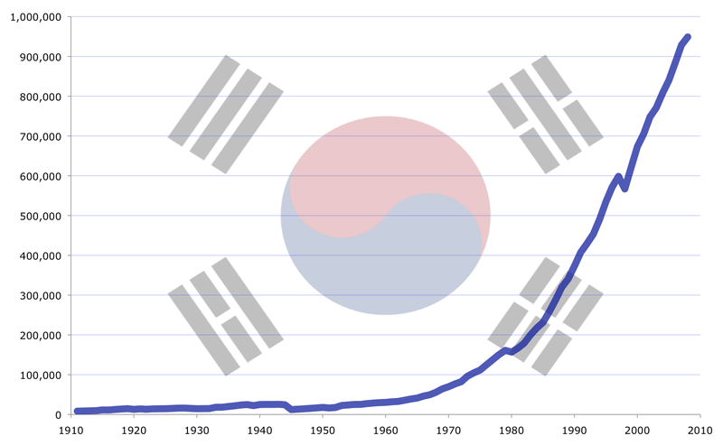
Importance
1/5th of South Korea's exports
35th richest country
Major influence of the “Miracle on the Han River”

Slide 10
SWOT
Strengths - Operates in various domains - Wins lots of money - None of its division loses money | Weaknesses - Children under 16 work in Chinese factories - Dozens of factory workers get leukemia - Terrible working conditions in factories
Opportunities - Electronics market is constantly growing - Can operate in developing countries | Threats - Often attacked for patent violation

